Slide 1
* @Media
-ns :: not small (min 30em)
-m :: medium (30em – 60em)
-l :: large (min 60em)
Display *
d[n | i | b | ib] :: none/inline/block/…
d[t | it] :: table/inline table
dt[c | [row | column [-group]]]:: cell …
Widths *
w[1-5] :: 1-2-4-8-16rem width
w-[10-100 | 25 | 33 | 34 | 75] :: %
w-[third | two-thirds | auto]
mw[1-9] :: 1-2-4-8-16-32-48-64-96rem max
mw-100 :: 100%
mw-none
Hover and Focus
dim :: to opacity .5
glow :: to opacity 1
hide-child / child
underline-hover
grow :: 1.05%
pointer
shadow
Debug
debug :: outline elements in gold
debug-[white | black]
debug-grid[-16 | [-8 | -16]-solid]
Grid
cf[:[before | after]] :: clearfix
f[l | r | n] :: float left/right/none *
Flexbox *
flex | inline-flex :: must always use one of these
flex-[none | [[row | column | wrap][-reverse]] | nowrap]
items-[start | end | center | baseline | stretch]
self-[start | end | center | baseline | stretch]
justify-[start | end | center | between | around]
content-[start | end | center | between | around | stretch]
order-[0-8 | last]
Z-Index *
z-[0-5 | 999 | 9999 | max | inherit | initial | unset]
Box Model
p[a | v | h | l | r | t | b][0-7] :: padding (0-16rem) *
m[a | v | h | l | r | t | b][0-7] :: margin (0-16rem) *
center :: l/r margin auto *
m[l | r]-auto *
border-box :: generally the default
Outlines and Shadows *
outline
outline-transparent
outline-0
shadow-[1-5]
Typography *
f[1-7] :: font size
measure[-[wide | narrow]]
indent
small-caps
truncate :: no wrap + …
lh-[solid | title | copy] :: line height
tracked[-tight | mega] :: UC letter spacing
fw[1-9] | normal | b :: font weight
fs-normal | i :: font style
v-[base | top | mid | btm] :: vert align
t[l | c | r | j] :: text justify
tt[c | l | u | n] :: text transform
strike | underline | no-underline
nowrap | ws-normal | pre :: white space
clip :: hidden but accessible text
Heights *
h[1-5] :: 1-2-4-8-16rem height
h-[25 | 50 | 75 | 100] :: % in parent with declared height
min-h-100 :: min height 100%
vh-[25 | 50 | 75 | 100] :: % screen height
min-vh-100 :: min screen height 100%
h-[auto | inherit] :: auto/inherit height
Position *
static
relative
absolute[--fill]
fixed
[top | right | bottom | left]-[0-2] :: rem
Other
link :: remove link underline
list :: remove list bullets
input-reset
button-reset
Tables
collapse :: border collapse
striped--light-silver:nth-child(odd)
stripe-[light | dark]:nth-child(odd)
Opacity
o-[0 | 025 | 05 | 10-100]
Tachyons Cheat Sheet v4.10.0
athelas | georgia | times | bodoni | calisto | garamond | baskerville
helvetica | avenir code | courier [system-][serif | san-serif]
CC0 Scott V. Kissinger 2019

Slide 2
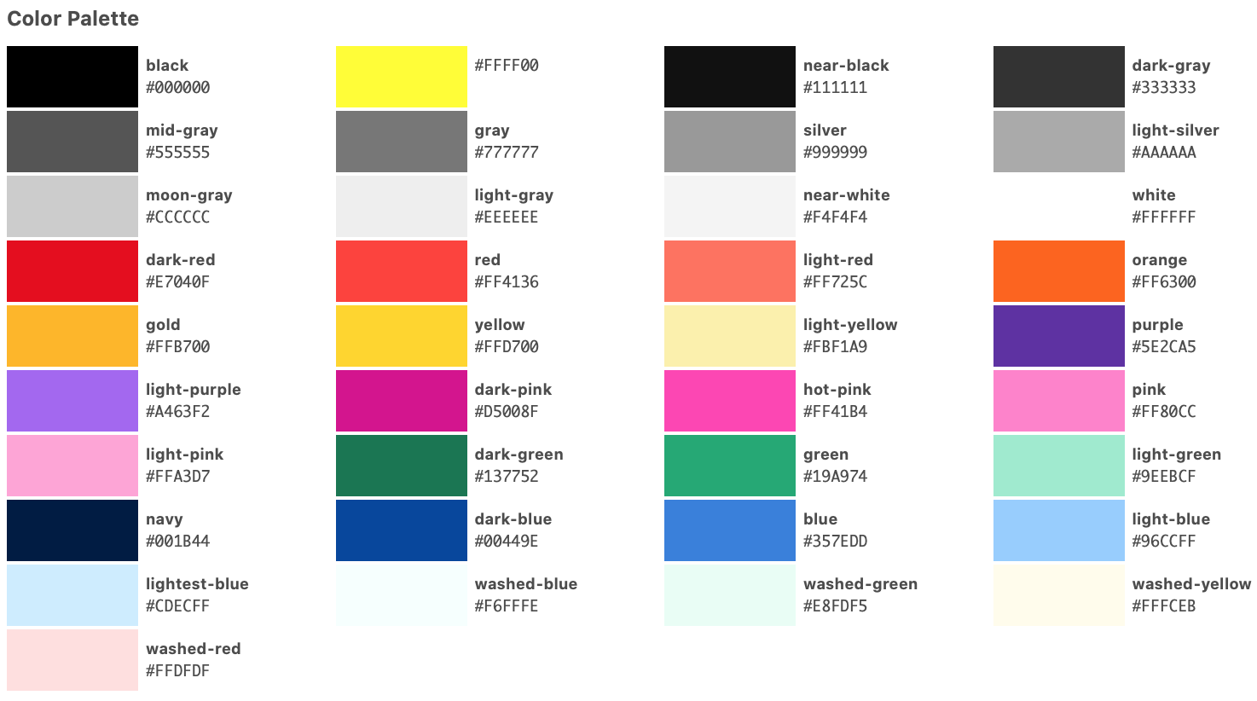
Borders *
bw[0-5] :: 0-.125-.25-.5-1-2rem width
b[t | r | b | l]-0 :: reset border
br[0-4] :: 0-.125-.25-.5-1rem radius
br-[100 | pill] :: 100% or pill
br--[top | right | bottom | left]
b--[none | dotted | dashed | solid]
Background Position *
bg-[center | top | right | bottom | left]
Background Image Size *
contain :: show entire image
cover :: cover entire element
Overflows *
overflow-[visible | hidden | scroll | auto | -x-visible | -x-hidden | -x-scroll | -x-auto | -y-visible | -y-hidden | -y-scroll | -y-auto]
overflow-container :: adds y scroll
Rotations *
rotate-[45 | 90 | 135 | 180 | 225 | 270 | 315]
Text Colors
color-inherit
black-[05 | 10-90]
white-[10-90]
[colors to right]
Background Colors
bg-inherit
bg-black-[05 | 10-90]
bg-white-[10-90]
bg-transparent
bg-[colors to right]
Border Colors
b--[colors to right]
Link Colors
<a class="[colors to right] …></a>

